Slide 1

Decryption Outsourcing for Functional Encryption Using Blockchain - Pay as you decrypt
TEAM DETAILS
Sireesha Dasari (20EG105251)
Gorre Pavan (20EG105215)
Gudipati Saketh Kasyap (20EG105223)
Project Supervisor
Name: Mrs. K. Jyothi
Designation: Assistant Professor

Slide 2
Introduction
The project deals with pay as you decrypt mechanism.
Constructing a framework to solve the limitation caused by public-key encryption by considering the functional encryption (FE) as an encryption mechanism to protect data security and privacy in many emerging applications such as the cloud computing services.
Applications:
1) Data storage and file storage
2) Data sharing over the cloud

Slide 3
Abstract
The concept of functional encryption (FE) has been introduced to address the shortcomings of public-key encryption (PKE) in many emerging applications which require both data storage and data sharing (e.g., cloud storage service). One of the major issues existing in most FE schemes is the efficiency, as they are built from bilinear pairings of which the computation is very expensive. A widely accepted solution to this problem is outsourcing the heavy workloads to a powerful third party and leaving the user with the light computation. Nevertheless, it is impractical to assume that the third party (e.g., the cloud) will provide free services. To our knowledge, no attention has been paid to the payment procedure between the user and the third party in an FE with outsourced decryption (FEOD) scheme under the assumption that neither of them should be trusted. Leveraging the transactions on cryptocurrencies supported by the blockchain technology, in this project, we aim to design FE with payable outsourced decryption (FEPOD) schemes. The payment in an FEPOD scheme is achieved through a blockchain-based cryptocurrency, which enables the user to pay a third party when it correctly completes the outsourced decryption. We define the adversarial model for FEPOD schemes, and then present a generic construction of FEPOD schemes. Also, we evaluate the performance of the proposed generic construction by implementing a concrete FEPOD scheme over a blockchain platform.

Slide 4
Concept tree
User
SERVER
Data Base

Slide 5
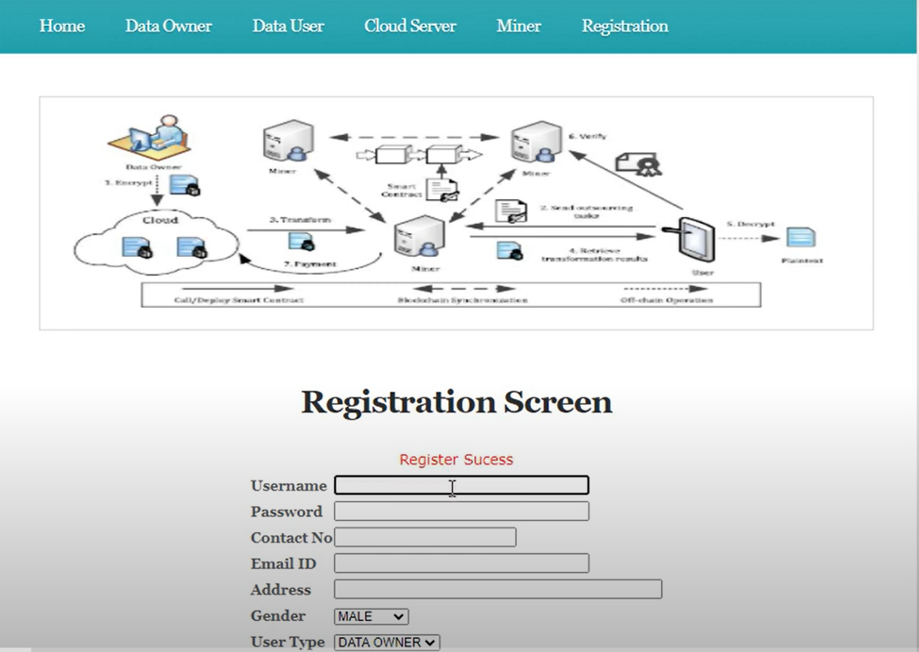
Implementation

Slide 6
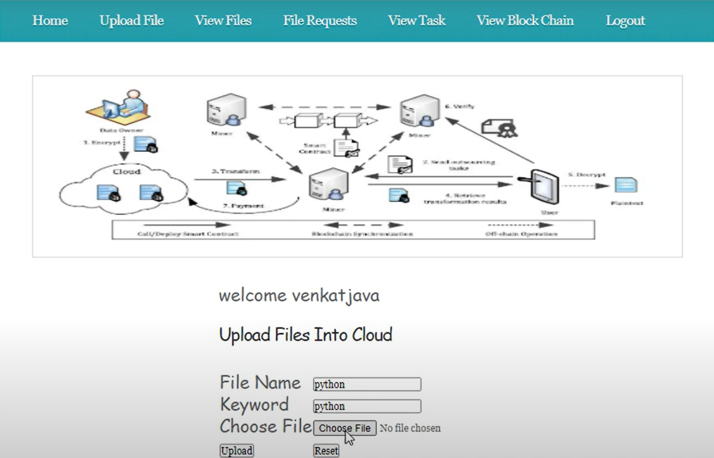

Implementation

Slide 7
Literature
Author(s) | Strategies | Advantages | Disadvantages
H. Cui, R. H. Deng, Y. Li, and B. Qin | Server-aided revocable attribute-based encryption | Enables a user to delegate the heavy computation to a third entity | Did not support real time application
W. Banasik, S. Dziembowski, and D. Malinowski | ZeroKnowledge contingent payments in cryptocurrencies | A seller is able to sell any piece of information that can be verified for a payment in Bitcoin | Fails to achieve the fair payment
V. Buterin | A Next Generation Smart Contract & Decentralized Application Platform | Smart contracts can be built upon cryptocurrencies | Failed during verification process

Slide 8
Literature (cont…)
Author(s) | Strategies | Advantages | Disadvantages
B. Parno, J. Howell, C. Gentry, and M. Raykova | Nearly practical verifiable computation | Correctness can be created in a more efficient way without using the ZK proofs | Needs knowledge in functional outsourcing
G. Wood | A Secure Decentralised Generalised Transaction Ledger | Ethereum, Blockchain that supports Turing-complete smart contracts | Complex
Y. Zhang, R. H. Deng, X. Liu, and D. Zheng | Blockchain based efficient and robust fair payment for outsourcing services in cloud computing | Integration of the FEOD scheme into the Bitcoin platform, and the fair exchange protocol presents a solution to enable the fair exchange of a cryptocurrency payment for a receipt | Need more improvements for user privacy

Slide 9
Problem Statement
Addressing the inefficiency of functional encryption (FE) schemes, often stemming from costly computations, the common approach of outsourcing to third parties lacks a standardized payment procedure.
This gap in functional encryption with outsourced decryption (FEOD) schemes, where neither party is inherently trusted, poses a challenge.
Finding a way to fill this void by proposing functional encryption with payable outsourced decryption (FEPOD) schemes.

Slide 10
Problem Illustration
Alice (User): Wants to securely store and share encrypted data using functional encryption.
Bob (Decryption Service Provider): Provides outsourced decryption services for functional encryption. Alice wants to compensate Bob for his decryption services but cannot fully trust him.
Blockchain System: Used to facilitate secure and transparent transactions between Alice and Bob.

Slide 11
Proposed Method
We focus on designing and implementing a concrete Functional encryption with payable outsourced decryption (FEPOD) schemes in a generic way, where the payment can be accomplished via a blockchain-based cryptocurrency and a platform to evaluate its feasibility and practicality.
An FEPOD scheme should enable efficient and public verification for the outcome of the outsourced decryption task. In other words, in an FEPOD scheme, anybody should be able to efficiently verify the correctness of the result solely based on the given public information.

Slide 12
Proposed Method
We propose a notion which allows anybody to check the correctness of the answer for the outsourcing computation task provided by an untrusted third party such that the payment can be processed by a blockchain-based cryptocurrency.
We describe the security model of an FEPOD scheme, present a generic construction of it, and analyze its security.

Slide 13
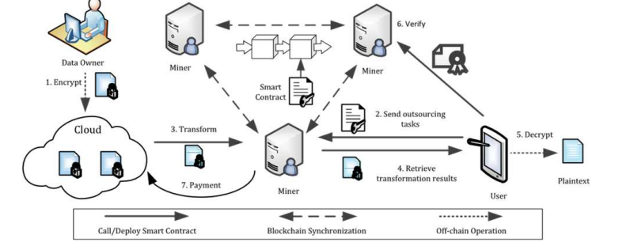
Proposed method illustration
Encrypt
Send outsourcing tasks
Transform
Retrieve transformation results
Decrypt
Verify
Payment

Slide 14
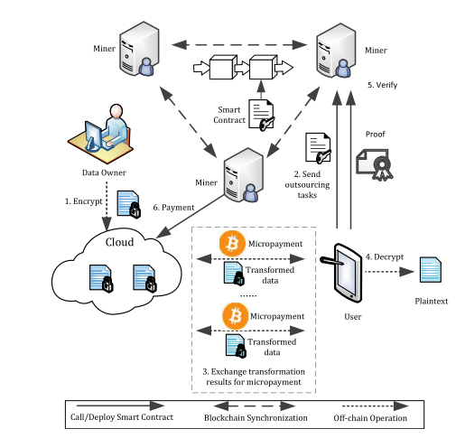
Proposed method illustration

Slide 15
Parameters
Payment Process:
Payment Trigger
Payment Amount
Verification and Auditing:
Proof of Decryption
Transaction Transparency
Security Considerations:
Cryptography Standards
Secure Communication
Scalability:
Performance Metrics

Slide 16
Experiment environment
SYSTEM REQUIREMENTS:
HARDWARE REQUIREMENTS:
Processor : i3 onwards
Hard Disk : 40 GB and above
Ram : 2 GB and above
SOFTWARE REQUIREMENTS:
Operating system : Windows 10 and above
Coding Language : JAVA
Data Base : MYSQL
IDE : Netbeans8.1
Server : Glassfish

Slide 17
Project status
S. No | Functionality | Status (Completed /in-progress/Not started)
1) | Creating a project model and framework | Completed
2) | Frontend of the project | In-progress
3) | Backend of the project | In-progress
4) | Connecting to cryptocurrency | Not started

Slide 18
References
[1] A Python Interface for Interacting With the Ethereum Blockchain and Ecosystem. Accessed: Jul. 10, 2019. [Online]. Available: https://github.com/ethereum/web3.py
[2] J. A. Akinyele et al., “Charm: A framework for rapidly prototyping cryptosystems,” J. Cryptograph. Eng., vol. 3, no. 2, pp. 111–128, Jun. 2013.
[3] B. Applebaum, Y. Ishai, and E. Kushilevitz, “From secrecy to soundness: Efficient verification via secure computation,” in Proc. 37th Int. Colloq. Automat., Lang., Program., in Lecture Notes in Computer Science, vol. 6198. Bordeaux, France: Springer, Jul. 2010, pp. 152–163.
[4] W. Banasik, S. Dziembowski, and D. Malinowski, “Efficient zeroknowledge contingent payments in cryptocurrencies without scripts,” in Proc. 21st Eur. Symp. Res. Comput. Secur., in Lecture Notes in Computer Science, vol. 9879. Heraklion, Greece: Springer, Sep. 2016, pp. 261–280
[5] I. Bentov and R. Kumaresan, “How to use bitcoin to design fair protocols,” in Proc. 34th Annu. Cryptol. Conf., in Lecture Notes in Computer Science, vol. 8617. Santa Barbara, CA, USA: Springer, Aug. 2014, pp. 421–439.

Slide 19
Thank you

Slide 20
Project seminar 1 - Evaluation
S. No | Rubrics | Marks
1 | Concept Introduction | 4
2 | Literature and Parameter | 5
3 | Problem and Problem Illustration | 8
4 | Proposed Method and Illustration | 8
Total |  | 25

